Slide 1


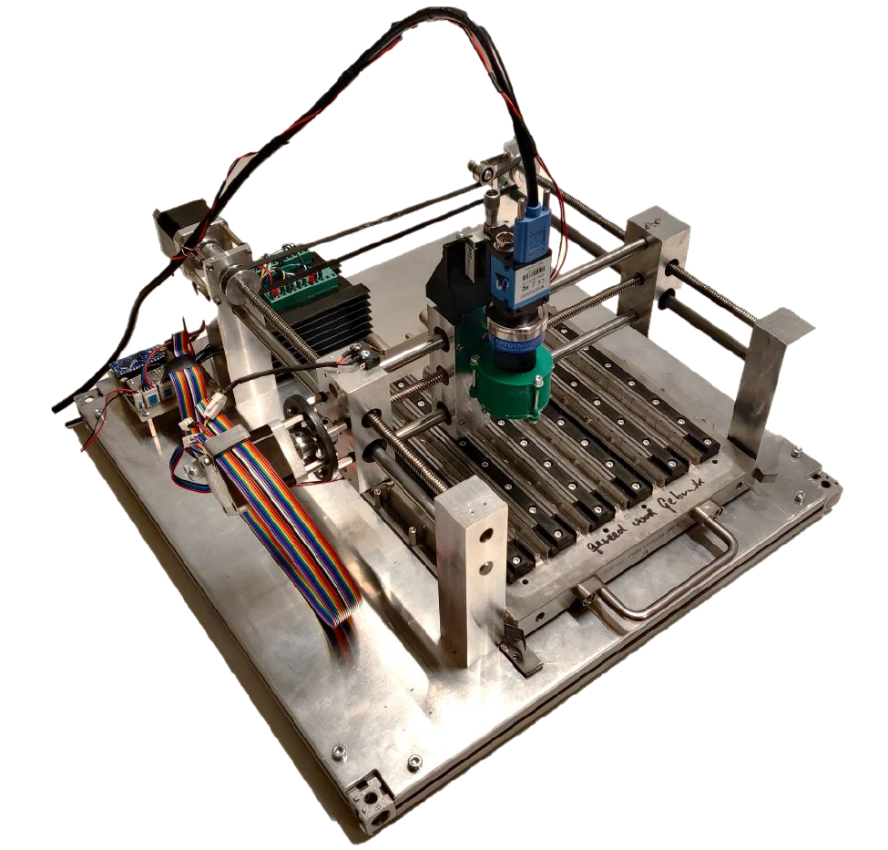
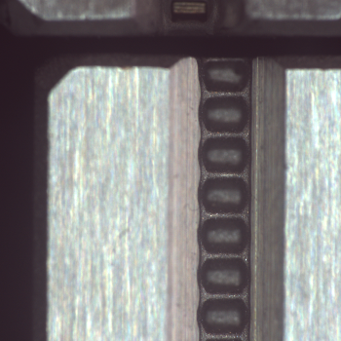
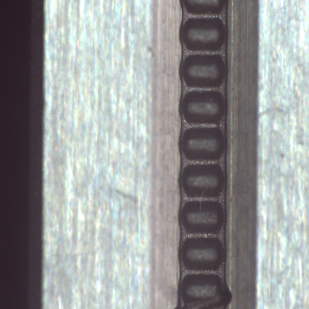
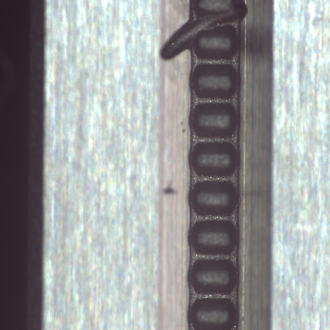
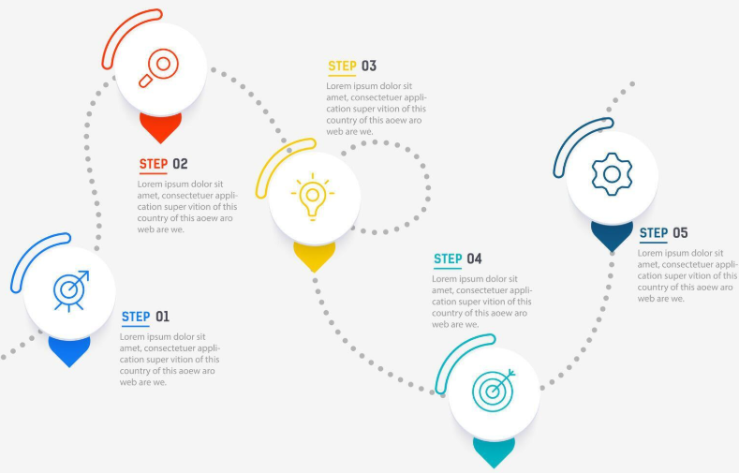
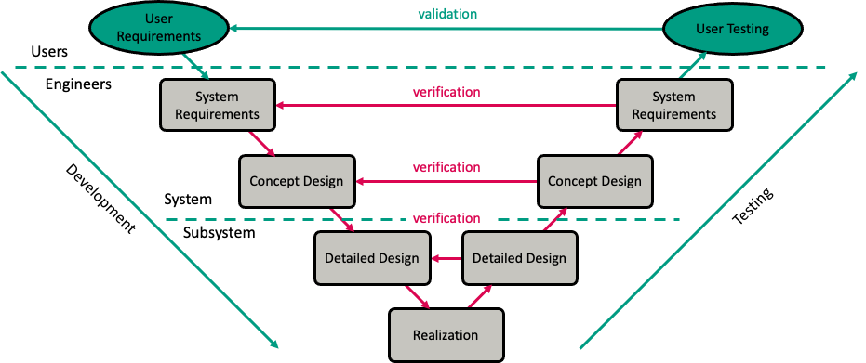
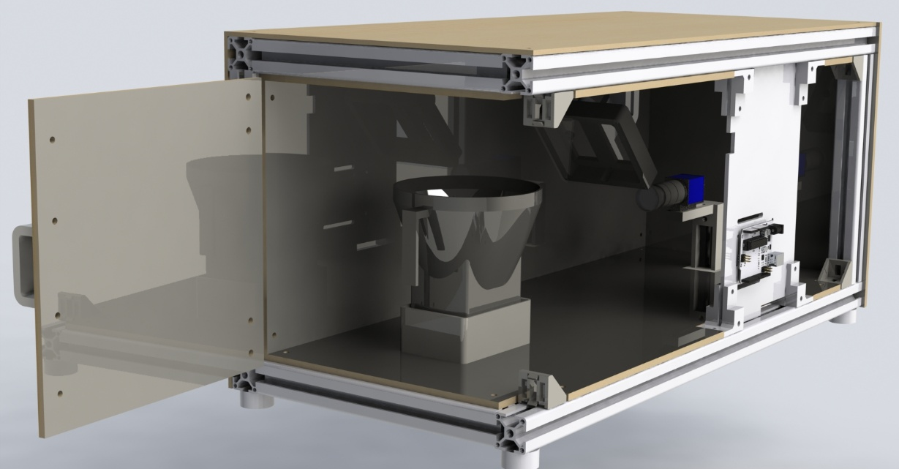
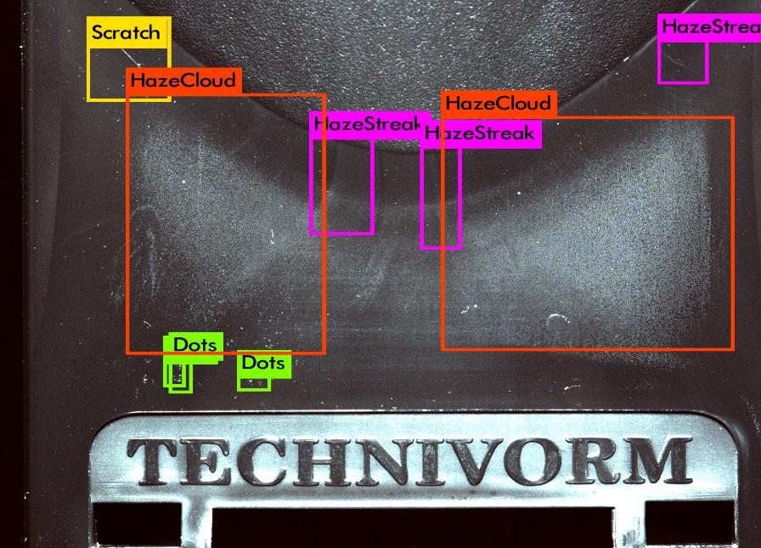
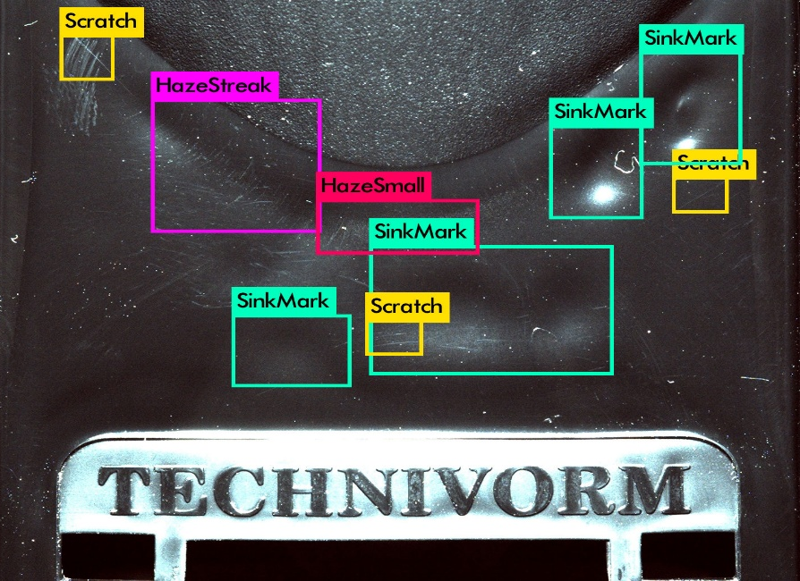
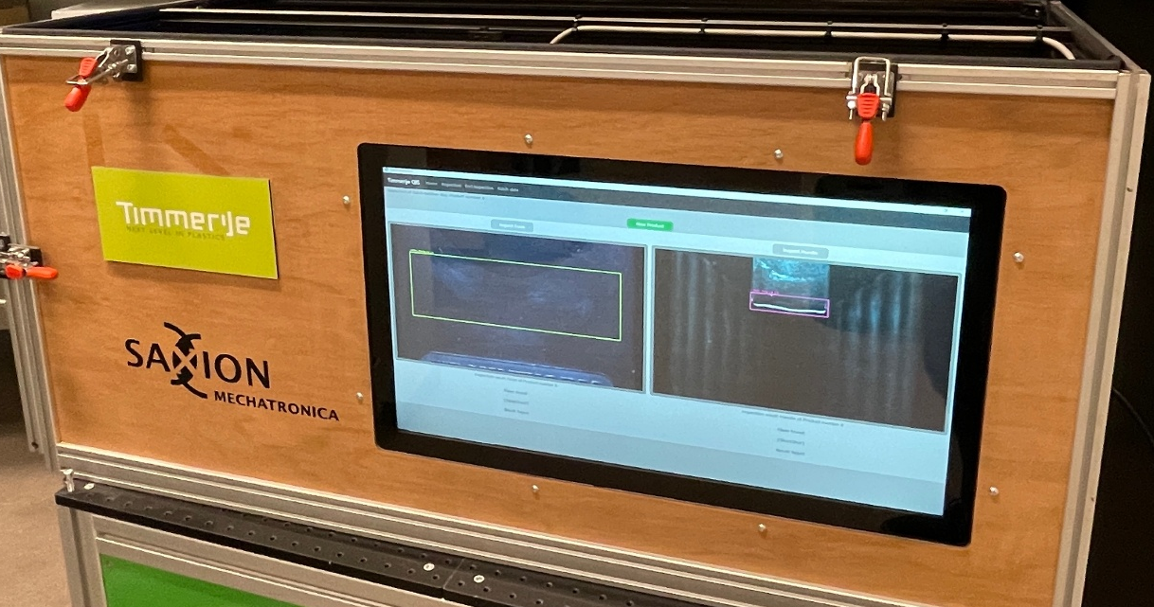
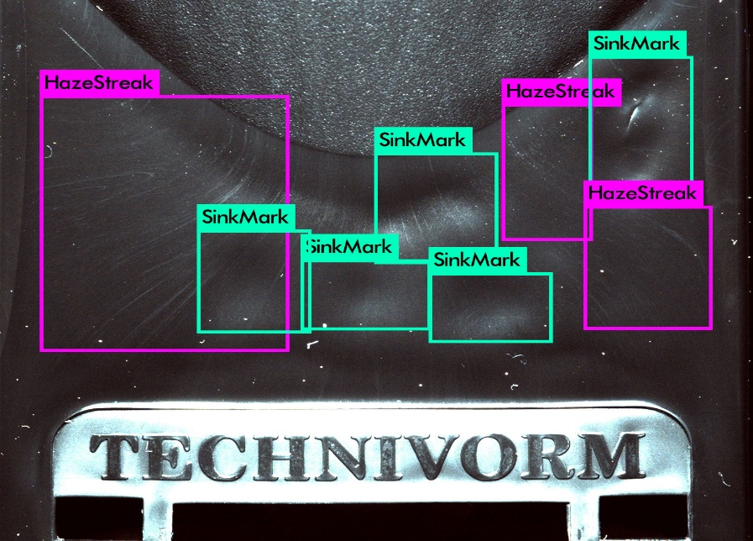
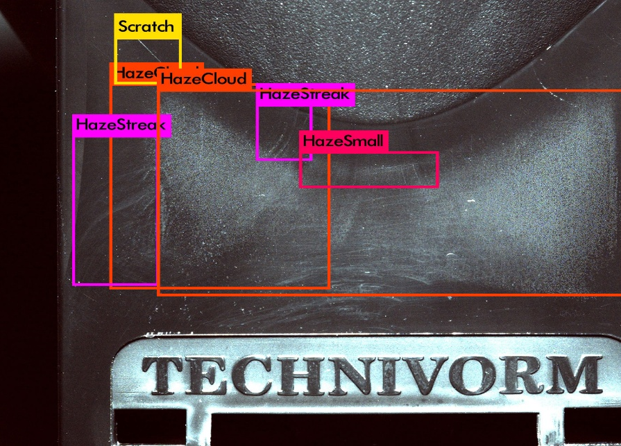
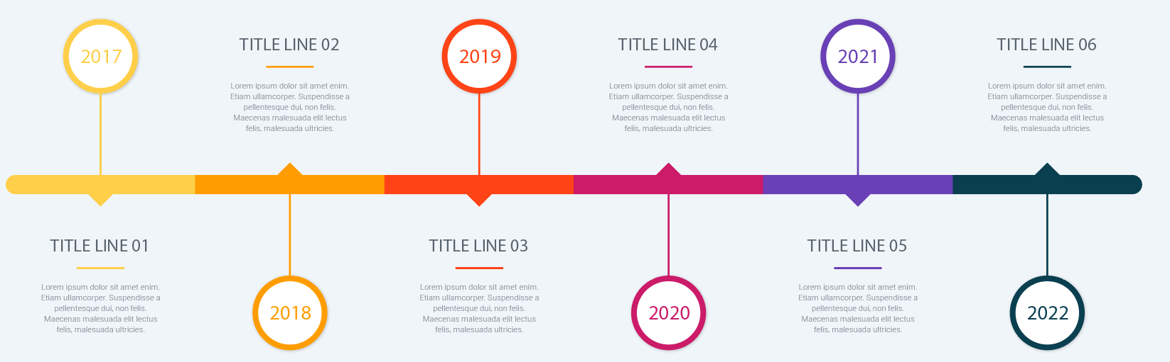
SCARA ARM ROBOT
Student team:
Supervisors:
Introduction project / research
Experiments & results
In order to achieve optimal results in modern agriculture, smart harvesting robots are the key to improve efficiency, reduce manual labor and waste. Using computer vision and sensors, the harvester can ensure optimal harvesting quality.
We are working on a fruit picking system that can detect the position and the ripeness of the fruit. Currently, we are working on comisioning the PLC to the axis, testing sensors and looking for ways to implement
What have you discovered so far? Highlighting preliminary results to demonstrate progress
[template guidance] – explain:
key insights from your research / project
preliminary / current results
supporting visualizations or data (see below)
Supporting visualisations or data to show results, e.g.:
OK
OK
NOT OK
Methodology and approach
Challenges and questions
Coming from different backrounds we divided our task into research, testing and documentation
Where do you need input? Highlight to get input from researchers
[template guidance] – explain:
current obstacles or limitations
specific questions for research group members / teachers
areas where you would appreciate guidance / input
supporting visualizations or data (see below)
Supporting visualisations or data to request guidance / input, e.g.:
Figure 1: Project approach with V-model methodology
Timeline and progress
Visual timeline with progress indicators - where are you in your research phase?
Discussions and next steps
Showing forward thinking and planning. Explicit conversations starters to encourage engagement for interaction.
[template guidance] – let’s talk about….:
planned activities for next phase
adjustments to the original plan
expected results
have you encountered similar challenges in your research / work?
what alternative approaches might be worth exploring?
Phase | Timeline | Status | Key achievements
initial research | [dates] | ✓ complete | [brief description]
development | [dates] | 🔄 in progress | [brief description]
integration | [dates] | ⏳ upcoming | [brief description]
testing | [dates] | ⏳ upcoming | [brief description]
More information can be found on our website:
Acknowledgements
https://www.saxion.nl/onderzoek/lectoraten/smart-mechatronics-and-robotics
You can thank companies, supervisors, colleagues and everyone else here.

